Slide 1

By Shivam Kumar
Data Science with Python Career Program - Internship Project

Slide 2

Agenda
Data Exploration
Data insights
EDA Graphs.
Graphical Analysis and conclusion on Data
Data Cleaning & Pre-Processing Steps.
ML Modeling
Deployment of ML Models using Streamlit.

Slide 3
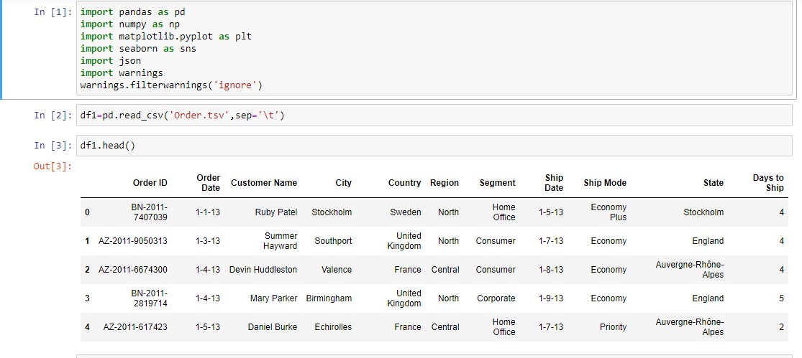
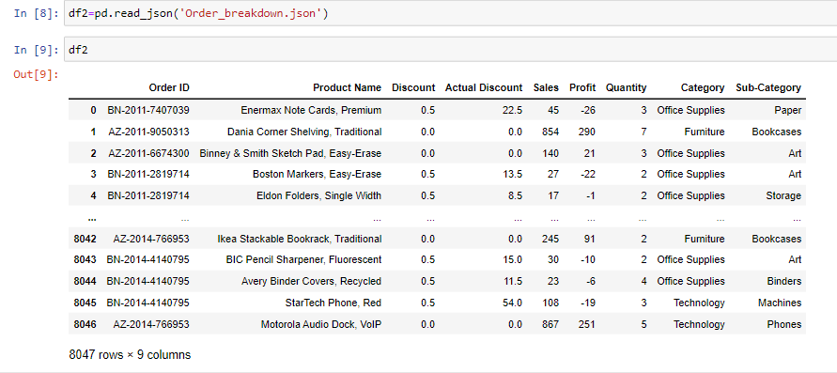
Data Exploration
In this project,we have two dataset one in table seperated column and second in json format.
Concatenated both the dataset for further insights.

Slide 4
Data insights
Summary of the dataset
-----------------------
1)Order Dataset
Order Dataset contains 4117 rows and 11 columns hence the shape of the dataset is (4117,11).
> Order ID- A unique identifier for each order(on which we will perform merge with another dataset).
> Order Date- The column which contains date on which order is placed (Since its datatypes is object so i had changed to datetime).
> Customer Name- This column signifies the name of the Customer who has placed the order.
> City- This column signifies from which city order has been placed.
> Country- This column signifies from which country order has been placed.
> Region- This column signifies from which region order has been placed.
> Segment- This column signifies the segment of the market the customer belongs to.
> Ship Date- This column signifies the date on which the product has been shipped for delivery(since its datatype is object so i had changed to datetime).
> Ship Mode- This column signifies the method used to ship the order.
> State- This column signifies the state from which the order has been placed.
> Days to ship- This column signifies total number of days to reach.
2)Order Breakdown Dataset
Order Breakdown Dataset contains 8047 rows and 9 columns hence the shape of the dataset is (8047,9).
> Order ID- Generated order id for each order(on which we will perform merge with another dataset).
> Product Name- This column signifies the name of the product ordered.
> Discount- This column signifies the discount which has been allocated for specific product.
> Actual Discount- This column signifies actual discount the product was having.
> Sales- This column signifies sales of particular product.
> Profit- This column signifies profit from particular product.
> Quantity- This column signifies quantity of the product.
> Category- This column signifies categories of the product.
> Sub-Category- This column signifies sub-category of the product.

Slide 5
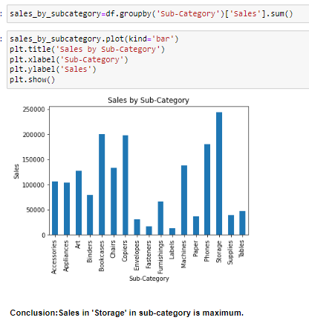
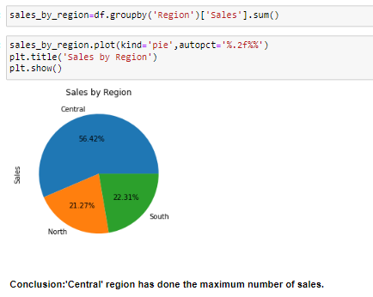
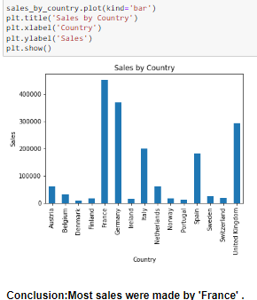
EDA Graphs.

Slide 6
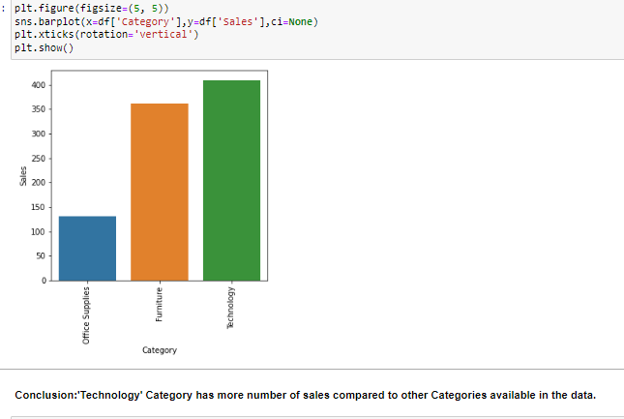
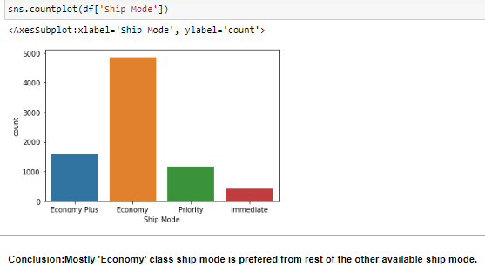
Graphical Analysis and conclusion on Data

Slide 7
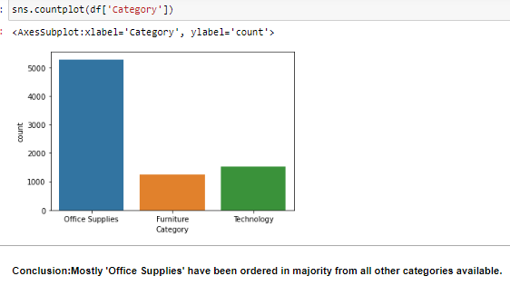
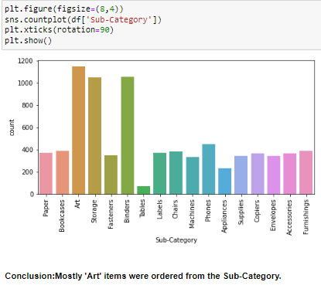
Graphical Analysis and conclusion on Data

Slide 8
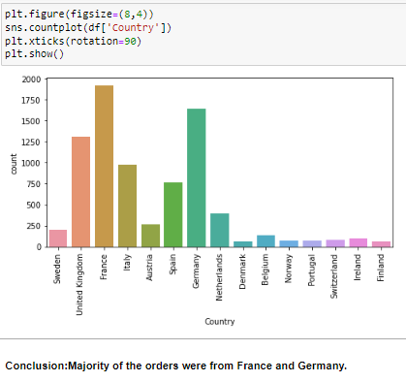
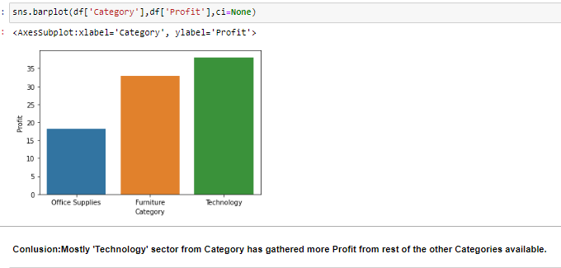
Graphical Analysis and conclusion on Data

Slide 9
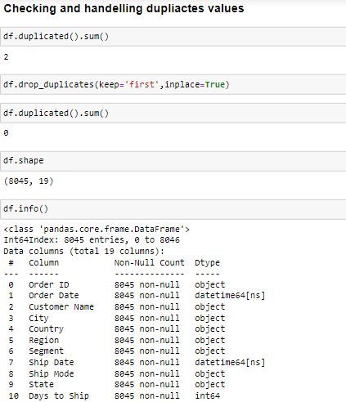
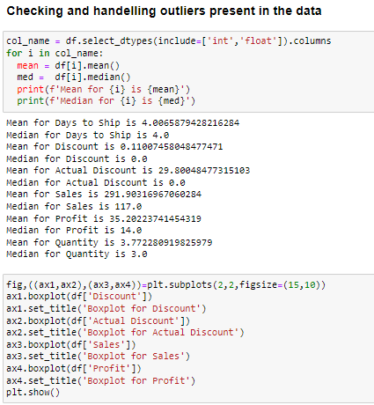
Data Cleaning & Pre-Processing Steps.

Slide 10
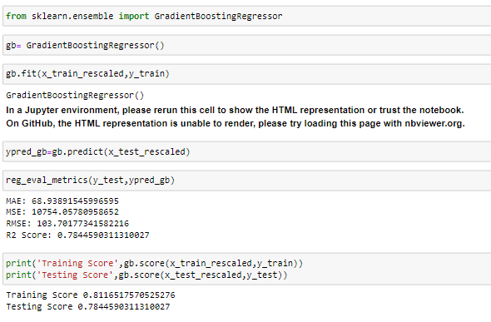
ML Modeling
Selected Gradient Boosting Regressor for this project,
Training data score-81%
Testing data score-78%
While looking both the score clearly we can say the model is overfitted but the model is predicting the desired value very consisely thats the reason to choose the machine learning algorithm.

Slide 11
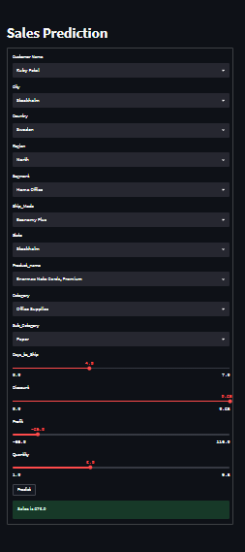
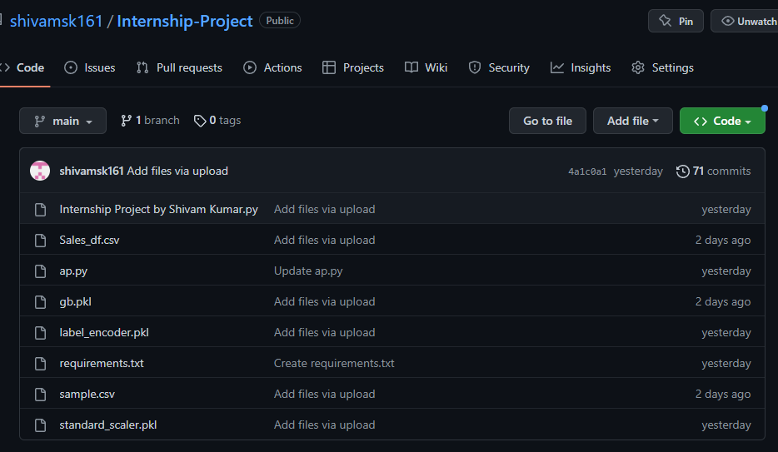
Deployment of ML Models using Streamlit.

Slide 12
Endnotes
Reference Links:-
Github: https://github.com/shivamsk161/Internship-Project
Streamlit: https://shivamsk161-internship-project-ap-ro9l11.streamlit.app

